Slide 1
GOLF – FEBRUARY 2018
DISCIPLESHIP – Serving Others in Christ’s Name
Notes:
Welcoming Song: The Servant Song

Slide 2
AGENDA
Matthew 25: 35-40
Psalm 40
Sharing Questions
Discipleship Inventory
Corporal Works of Mercy
Creating Your Discipleship with God
Things to Do Here
Lent is Coming
Notes:
Have a volunteer read Matthew 25: 35-40
Hand out Psalm 40 to a volunteer to read.
3. Read the CCC 2447.

Slide 3
PSALM 40 RESPONSE
“Here I am, Lord; I come to do Your will”.
Notes:
All: Respond.

Slide 4
SHARING QUESTIONS
Notes:
Allow 5-10 minutes for the table groups to go through and discuss the sharing questions.
Conduct a brief review afterward.
Hand out “Discipleship Inventory” one (1) per person.

Slide 5
DISCIPLESHIP INVENTORY
Notes:
While this slide is up the group will be completing their Discipleship Inventory.
While they are doing this consider reading the scripture on this slide from the Bible.

Slide 6
Notes:
Video: Corporal Works of Mercy – Introduction
Discussion on the video.
Hand out “Creating My Discipleship with God” one (1) per person.

Slide 7
Creating Your Discipleship with God
Notes:
Song: “Here I am, Lord”.

Slide 8
Notes:
.

Slide 9
Notes:
Go through the St. Pius X web site.
Inform the group on the activities offered year-round and during Lent.

Slide 10
Notes:
Time permitting; Bishop Barron presentation on Lent.
Distribute the “Closing Prayer”.

Slide 11
Questions for Reflection
What did you learn today that you want to remember?
What talent of yours might you be willing to share in the service of others?
What is something Jesus might want you to share to serve others?
What might you consider during Lent to prepare for the Resurrection of our Lord?
Notes:
Sending Forth Prayer
Play “Go Make a Difference”.

Slide 12
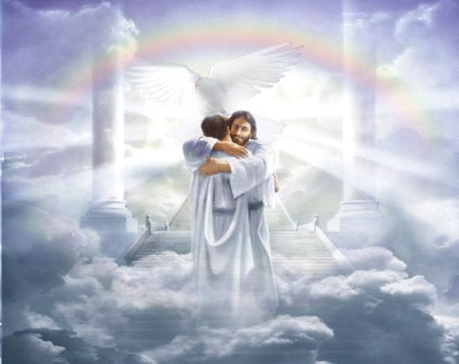
Notes:
Our ULTIMATE GOAL!

Slide 13
BACK-UP

Slide 14
Notes:
Talk #2: The Incarnation Through Space and Time.

