Slide 1
GOLF – OCTOBER 2019
DISCIPLESHIP – Serving Others in Christ’s Name
Notes:
Welcoming Song: The Servant Song

Slide 2
AGENDA
Introduction
Refresher
Exercise
What can I do?
Go Forth
Notes:
Have a volunteer read Matthew 25: 35-40
Hand out Psalm 40 to a volunteer to read.
3. Read the CCC 2447.

Slide 3
Notes:
.

Slide 4
Notes:
Allow 5-10 minutes for the table groups to go through and discuss the sharing questions.
Conduct a brief review afterward.
Hand out “Discipleship Inventory” one (1) per person.

Slide 5
Creating Your Discipleship with God
Notes:
Song: “Here I am, Lord”.

Slide 6
DISCIPLESHIP INVENTORY
Notes:
While this slide is up the group will be completing their Discipleship Inventory.
While they are doing this consider reading the scripture on this slide from the Bible.

Slide 7
PSALM 40 RESPONSE
“Here I am, Lord; I come to do Your will”.
Notes:
All: Respond.

Slide 8
Notes:
Go through the St. Pius X web site.
Inform the group on the activities offered year-round and during Lent.

Slide 9
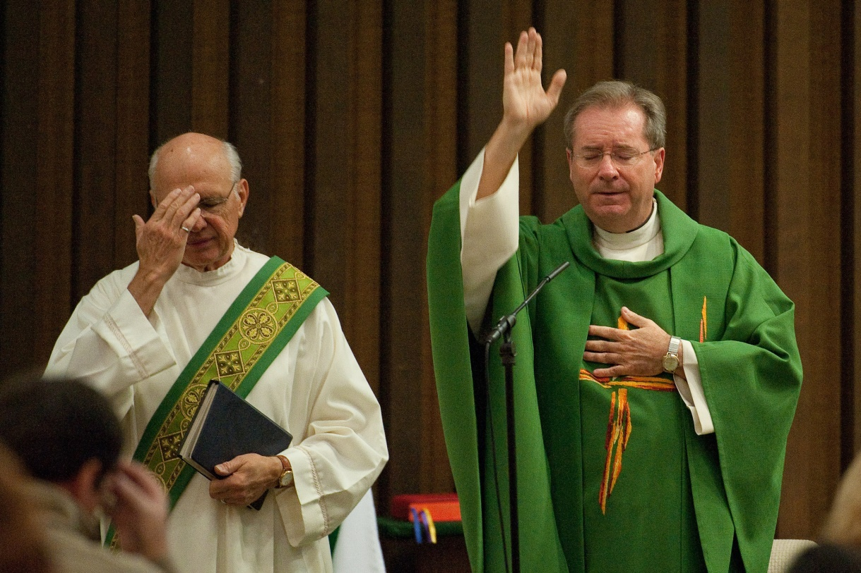
Concluding Rites
Blessing
-The priest and people share a last greeting and the priest blesses the people.
Dismissal
-We are sent out refreshed and strengthened to carry out the gospel in our community.

Slide 11
Notes:
READ MATTHEW 26 35-45

Slide 12
Questions for Reflection
What did you learn today that you want to remember?
What talent of yours might you be willing to share in the service of others?
What is something Jesus might want you to share to serve others?
What might you consider to assist in building Christ’s Church?
Notes:
Sending Forth Prayer
Play “Go Make a Difference”.

Slide 13
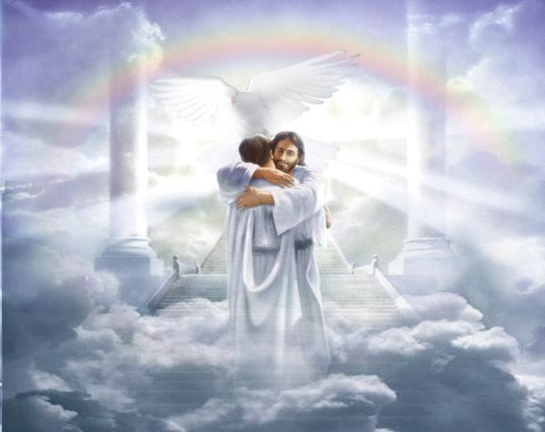
Notes:
Our ULTIMATE GOAL!

Slide 14
BACK-UP

