Slide 1
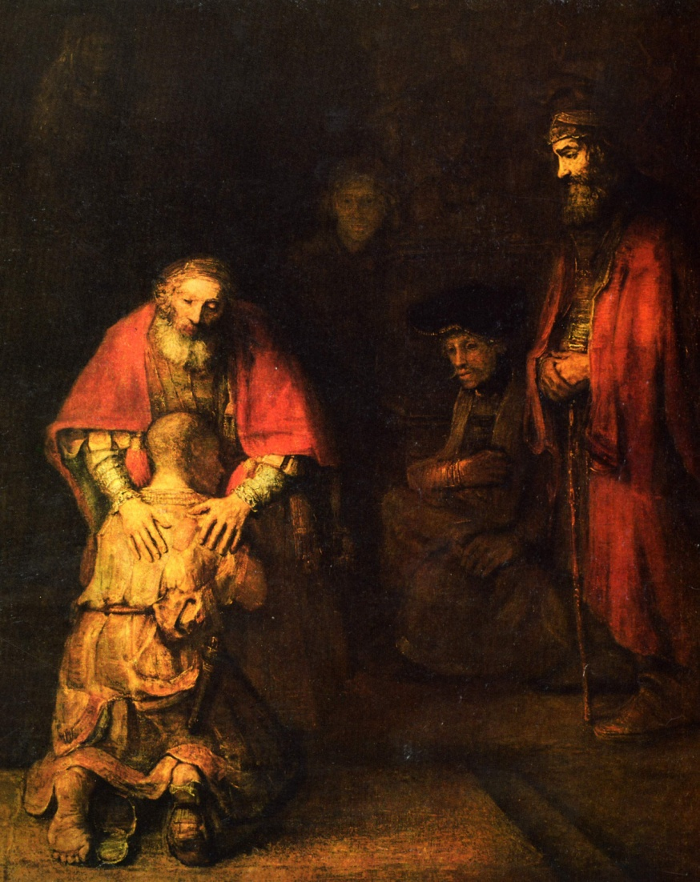
Forgiveness and Reconciliation

Slide 2
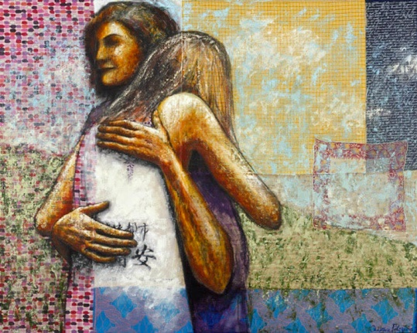
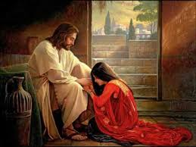
Process of Reconciliation Step 1
Contrition and Repentance:
We demonstrate knowledge that we have sinned.
We have broken the relationship between ourselves and another party.
We admit the sin and show contrition toward having committed the offense.

Slide 3
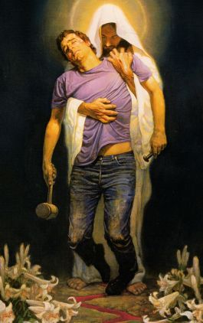

Slide 4
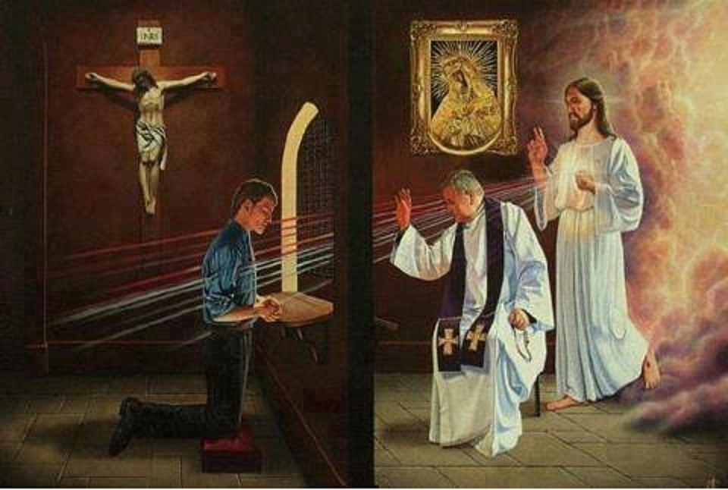
Process of Reconciliation Step 2
Confession:
We verbally express what we have done wrong, naming the sin at the root of the problem.

Slide 5
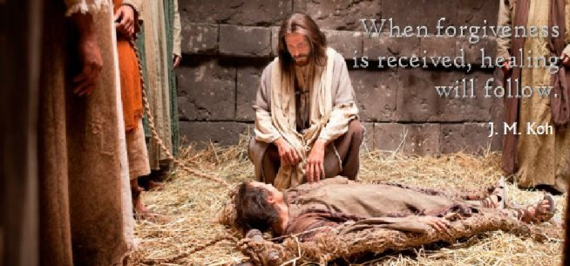

Slide 6
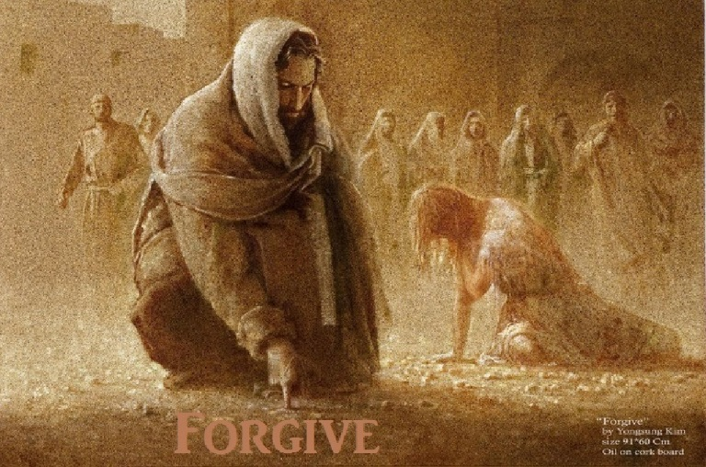
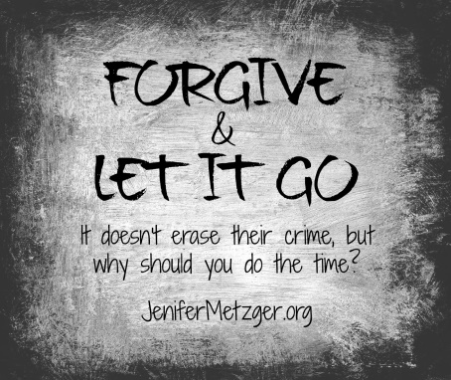
Process of Reconciliation Step 3
Pardon and Forgiveness:
We say the words, “I am sorry.”
We invite forgiveness from the offended party.
The one offended may or may not choose to forgive us, but we, nonetheless, must invite a renewed relationship, one free of pain, harm , bitterness or conditions.

Slide 7
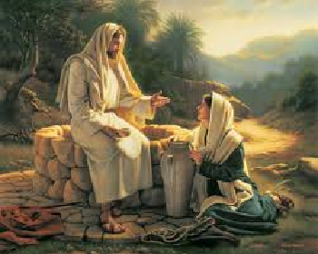
There is a way through……

Slide 8
Process of Reconciliation Step 4
Penance and Reconciliation:
We show in our words and behavior that we are willing to change the behavior;
We demonstrate conversion – a turning from one self to a new self. And
With that change we begin to enjoy deep and abiding peace within ourselves, with others, and most especially, with God.
We begin recognize that we have been changed by this process, that we have been transformed, made new. In short, reconciled.

Slide 9
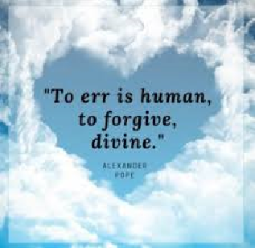

Slide 10
