Slide 1
GOLF – March 2020
Stewardship
Notes:
Welcoming Song: We Belong to You

Slide 2
AGENDA
Introduction
Refresher
What is it?
What it is not?
Group Exercise
Summary & Reflection
Go Forth
St. Pius X
Catholic Community

Slide 3
INTRODUCTION
Which of the following would you normally associate with being part of stewardship?
Soul | History | Emotions | Money
Arts | Technology | Planet | Relationships
Mind | Politics | Decisions | Body

Slide 4
INTRODUCTION
“Without cost you have received; without cost you are to give”.
MATTHEW 10:8
Notes:
The gifts you’re given – give to others.
Learn to Love to Live
READ: Matthew 25:14-30

Slide 5
REFRESHER GOLF – OCTOBER 2019
DISCIPLESHIP – Serving Others in Christ’s Name

Slide 6
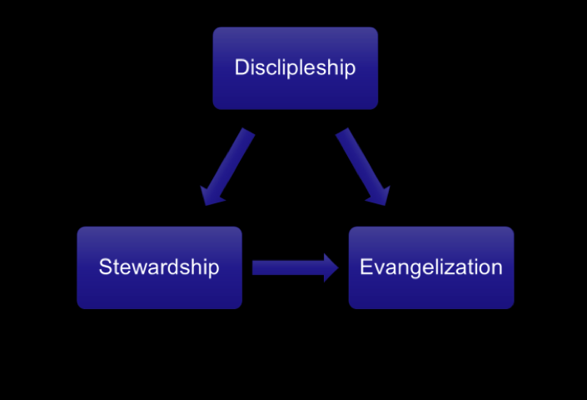
How Does Stewardship Fit In?
Following Christ’s command to share the Good News with the world.
Following God’s instructions to be fruitful with His Gifts.
Using our Gifts from God to build His Kingdom on earth.
Notes:
Discipleship: is our response to Christ’s offer to “Come, follow me”. It is a vocation to holiness and to evangelizing the world as directed by Jesus.
Evangelization: is our fundamental mission as disciples to spread the Good News.
Stewardship: is how we manage all the gifts God has given us as we endeavor to follow Him as disciples and carry out His mission of evangelization. All express actions. They are not passive concepts. They can and should affect how we live our lives. They are related terms that support and build on each other; but Discipleship is at the heart. Once one is a disciple; evangelization and stewardship follow naturally and almost automatically.

Slide 7
Following Christ’s command to share the Good News with the world.
Following God’s instructions to be fruitful with His Gifts.
Using our Gifts from God to build His Kingdom on earth.

Slide 8
What Does It Mean?
Stewardship means respecting and sharing our resources as an expression of gratitude to God.
It reminds us we are the administrators, not the owners, of our assets.
Christian stewardship can be identified by several meaningful characteristics, the most important being that it strengthens our relationship with God.
It is a way of life, not a program that has a beginning and an end.
Stewardship calls us to share a portion of our time, talent, and treasure so that the Good News of Jesus Christ may be shared with those who do not know Him.

Slide 9
Following Christ’s command to share the Good News with the world.
Following God’s instructions to be fruitful with His Gifts.
Using our Gifts from God to build His Kingdom on earth.
Notes:
FATHER MIKE Video

Slide 10
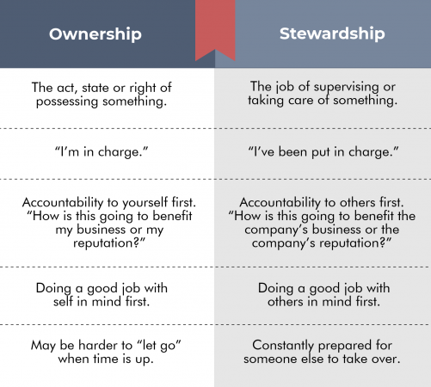
Stewardship is not…
Notes:
After discussion: Parable of Water video.

Slide 11
Acknowledge God as true owner of all we have.
Gratitude to God and others who have shared help us maintain a true sense of identity as Christ’s disciples.
Reminds us of all we do (and fail to do) with our time, talent, and money.
We are responsible to build Christ’s kingdom and will be accountable on the last day.
Propels us outside ourselves – often in ways which contradict our own interests.
This won Saints trued freedom and joy!
Giving is good for us! It is right and just to share what we have with others.
God wants us to take His gifts and develop them
Be productive; make a difference in the world!

Slide 12
Group Discussion Stewardship Through a Scriptural Lens

Slide 13
Notes:
Show and briefly discuss last three (3) St. Pius X bulletin articles on Everyday Stewardship.
Time – Talent – Treasure.

Slide 14
Summary & Reflection
What did you learn today that you want to remember?
What gift or gifts that you have been given might you be willing to share with others?
What is something Jesus might want you to share to serve others?
What might you consider to assist in building Christ’s Church?
Notes:
Sending Forth Song: “Go Make a Difference”.

Slide 15
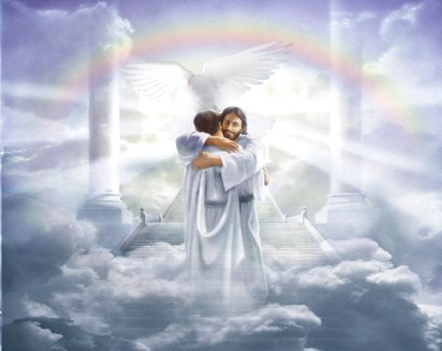
Notes:
Our ULTIMATE GOAL!

