Slide 1
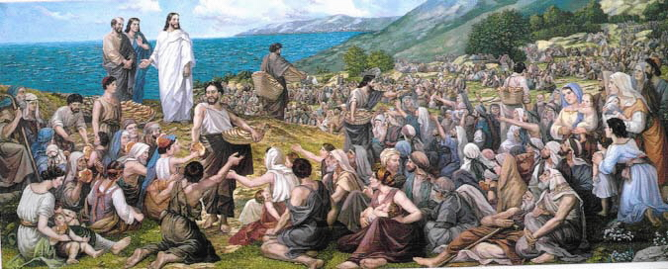
GOLF – DECEMBER 2017
Incarnation – God Among Us
Notes:
Intro Song

Slide 2
Notes:
Read John Chapter 1 verses 1-5.

Slide 3
ADVENT
a coming into place, view, or being; arrival:
the coming of Christ into the world.
the period beginning four Sundays before Christmas, observed in commemoration of the coming of Christ into the world.
Notes:
Source: Dictionary.com
A period of waiting and anticipation.
Announcement of the Birth of John to Zechariah.
Announcement of the Birth of Jesus tom Mary

Slide 4
Notes:
Week #1 started today!
Symbolism is shown in this slide – briefly summarize Advent as a time of preparation.
This is not the topic of this presentation but is the topic of the season and preparation for Christmas.

Slide 5
Notes:
This is what we believe and profess each week. This is not new and should not be a surprise.
Stress “consubstantial” and “by the Holy Spirit was incarnate of the Virgin Mary”.

Slide 6
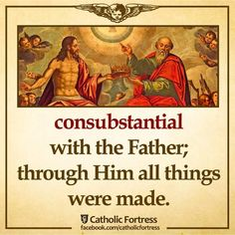
CONSUBSTANTIAL
verb (used with object) as in…
united in one common substance or nature.
regarded as so united.
Notes:
Big word – what does it mean?
Go back to the beginning. In the beginning was the Word….and the Word was with God….and the Word was God.

Slide 7
Notes:
Incarnation: another Big word. Here is where it came from.
3 minute video on Incarnation.

Slide 9
INCARNATION
living being embodying a deity or spirit.
assumption of human form or nature.
the doctrine that the second person of the Trinity assumed human form in the person of Jesus Christ and is completely both God and man.
a person or thing regarded as embodying or exhibiting some quality, idea,
Notes:
Source: Dictionary.com

Slide 10
Notes:
Incarnation fulfilled through the Nativity of our Lord.

Slide 11
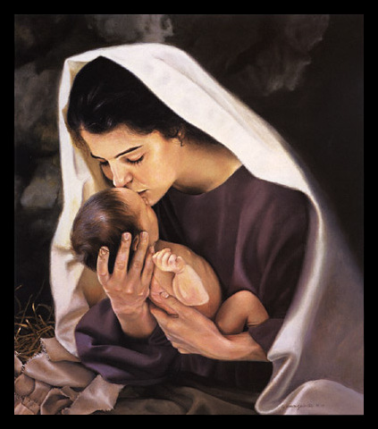
Notes:
More…
What do you feel when you see the baby Jesus?
Song: Messiah

Slide 12
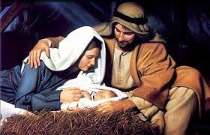
Notes:
Talk #2: The Incarnation Through Space and Time.

Slide 13
Questions for Reflection
What did you learn today that you want to remember?
What does the Incarnation mean to you?
What do you most appreciate about Jesus?
What do you want to do differently to keep Christ as the focus of your Christmas celebration?
Notes:
Closing Song: Mary Did You Know?

Slide 14
