Slide 1


Call to Family, Community, and Participation

Slide 2
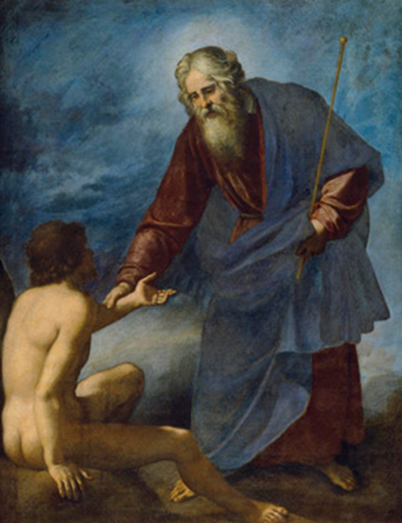
Sacred
Social
God looked at everything that he had made, and he found it very good. Gen 1:31
The Lord God said, “It is not good for the man to be alone.” Gen 2:18

Slide 3
Solitary Confinement

Slide 4
The Call to Family,
Community, & Participation
The person is not only sacred but also social. How we organize our society—in economics and politics, in law and policy—directly affects human dignity & the capacity of individuals to grow in community.

Slide 5

Agenda
Call to Family
Call to Community (The Common Good)
Call to Participation (Solving the Equation)

Slide 6
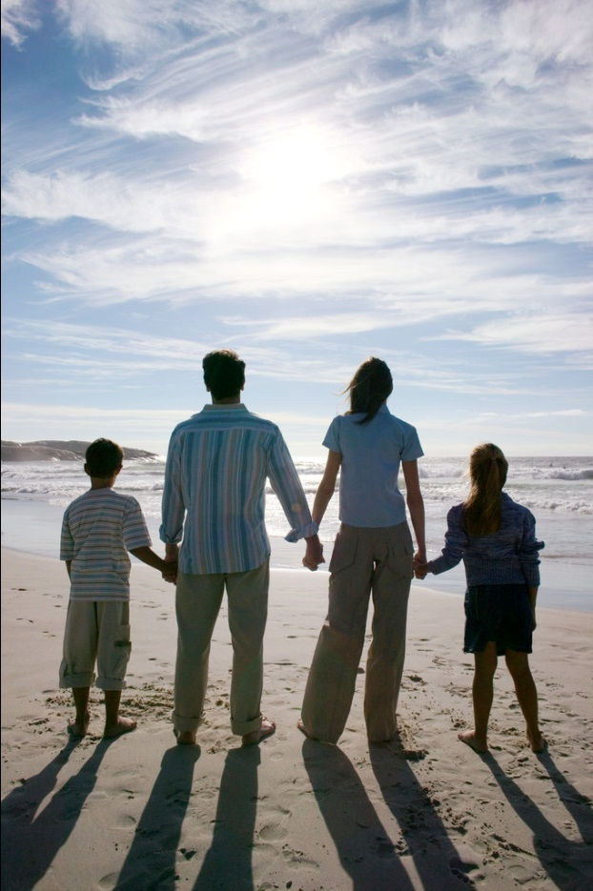
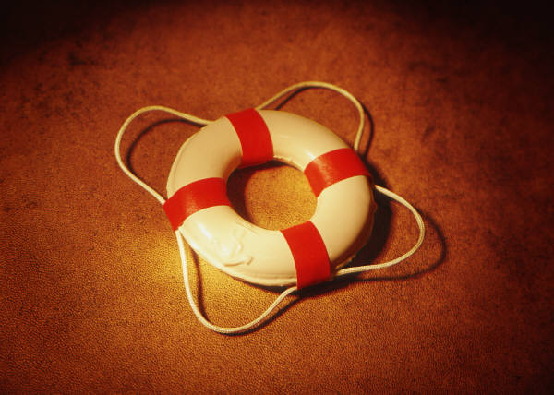
The Call to Family

Slide 7
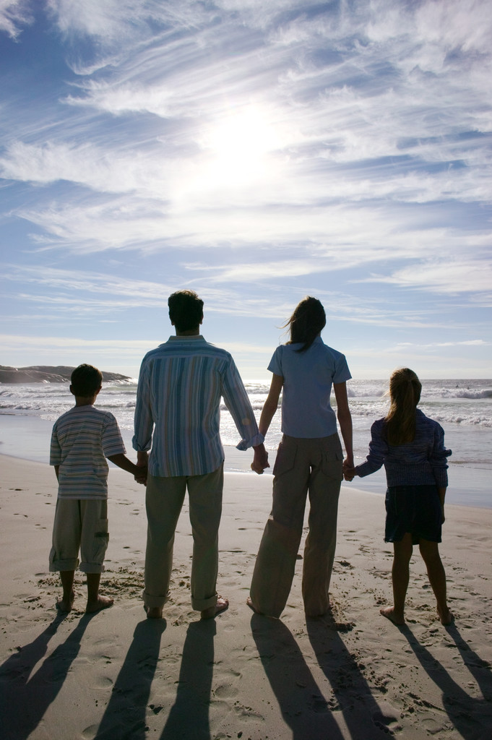
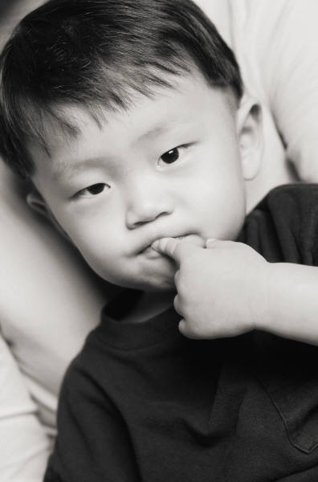
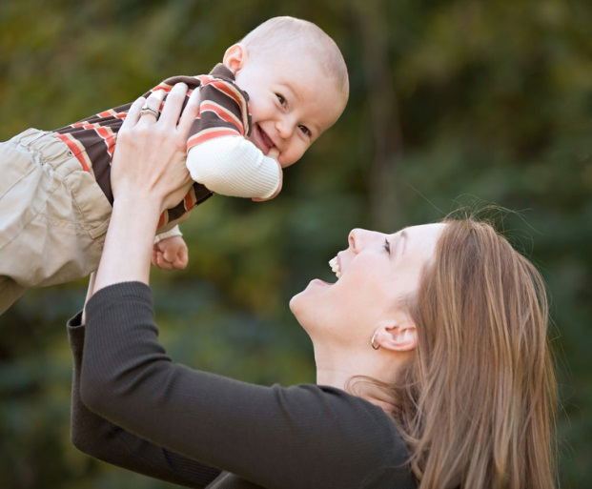
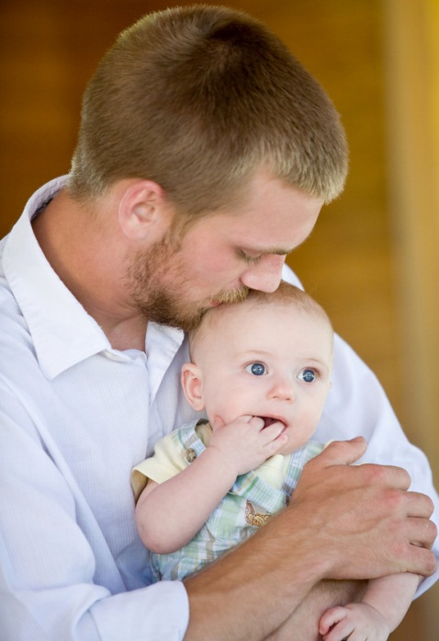
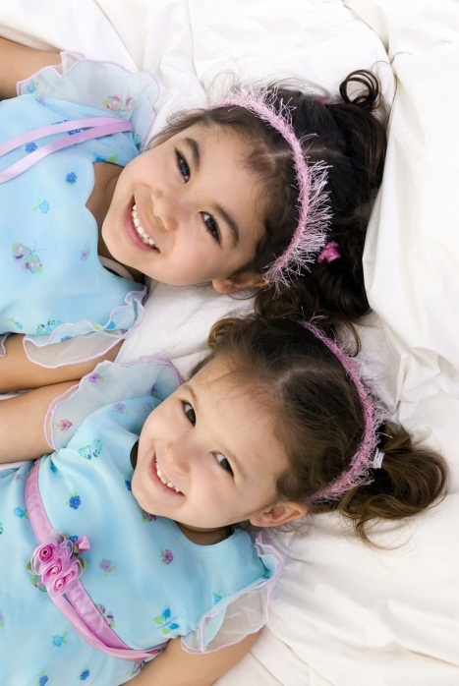
The Domestic (home) Church

Slide 8

The Family in God’s Plan
The family is the original cell of social life.
Family life is an initiation into life in society. #2207

Slide 9
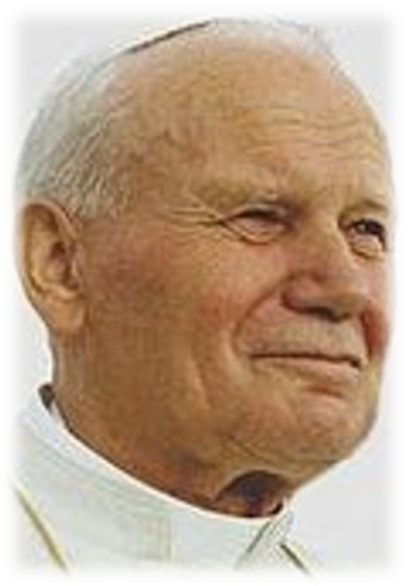
Pope John Paul II
It is necessary to go back to seeing the family as the sanctuary of life. The family is indeed sacred: it is the place in which life-the gift of God-can be properly welcomed and protected against the many attacks to which it is exposed, and can develop in accordance with what constitutes authentic human growth. In the face of the so-called culture of death, the family is the heart of the culture of life.”
(Centesimus Annus), no.39

Slide 10
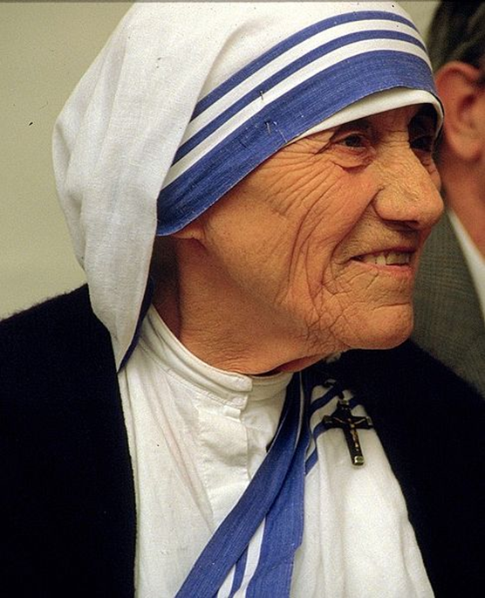
Mother Teresa
It is easier to give
a cup of rice
to relieve hunger
than to relieve
the loneliness and pain
of someone unloved
in our own home.

Slide 11

How does technology enhance and/or diminish family life?

Slide 12
The Call to Community

Slide 13
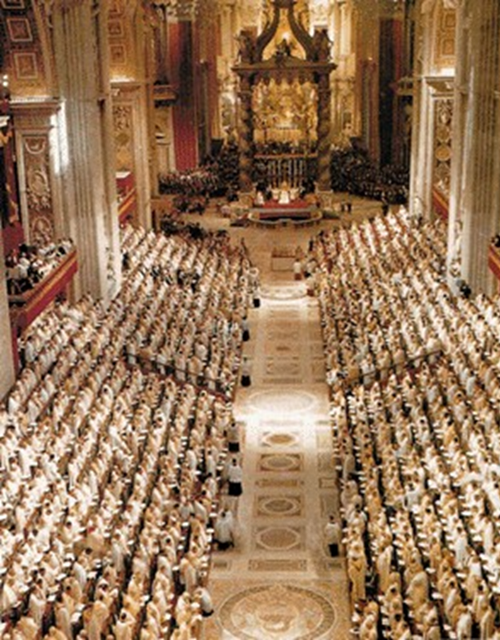
Vatican Council II (1962-65)
The joy and hope,
the grief and anguish of the people of our time, especially of those who are poor or afflicted in any way, are the joy and hope, the grief and anguish of the followers of Christ as well.
Gaudium et Spes #1

Slide 14

Commitment to the
Common Good
There was not a needy person among them,
for as many as owned lands or houses sold them and brought the proceeds of what was sold. They laid it at the apostles’ feet, and it was distributed to Each as any had need. Acts 4:34-35

Slide 15
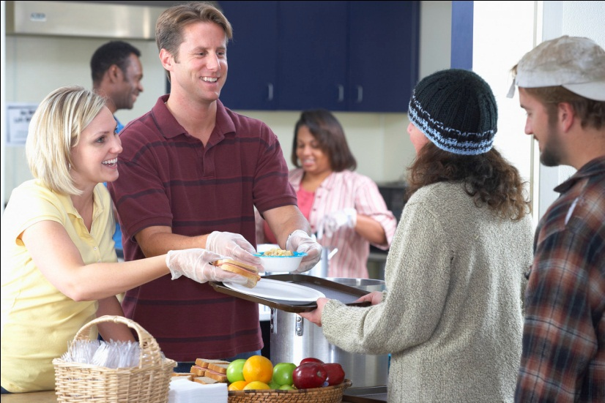
Our mission is not only to bring people
the message and grace of Christ,
but also to permeate and improve
the whole range of temporal things.
We are not only about saving souls;
being leaven means alleviating the suffering
and enhancing the life on our planet.
(Apostolate of Lay People #5)

Slide 16
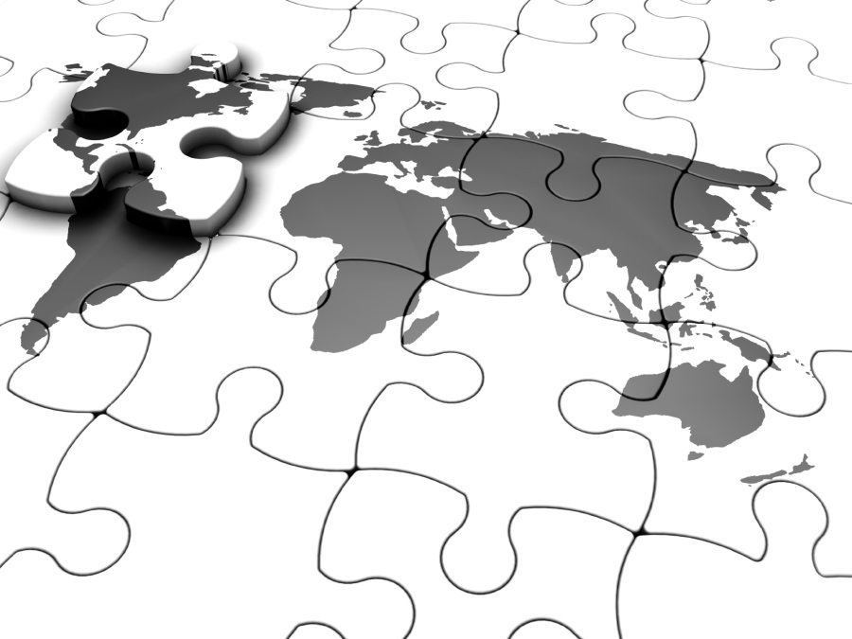
Because of the closer bonds of human interdependence & their spread over the whole world, we are today witnessing a widening of the role of the common good.
(Gaudium et Spes#26)
Let everyone consider it his sacred duty to count social obligations among the human person’s chief duties today and observe them as such.” (#30)

Slide 17
The pace of change is so far-reaching and rapid nowadays that no one can allow oneself to close his eyes to the course of events or indifferently ignore them and wallow in the luxury of a merely individualistic morality. The best way to fulfill one’s obligations of justice and love is to contribute to the common good.” (Gaudium et Spes #30)

Slide 18

The Common Good
By the common good is to be understood “the sum total of social conditions which allow people, either as groups or as individuals, to reach their fulfillment more fully and more easily” (Gaudium et Spes 26) The common good concerns the life of all….” (CCC 1906)
3 Essential Elements…
Respect for human persons
Social well being and development
Peace

Slide 19

The Call to Participation
Participation is the voluntary & generous engagement of a person in social interchange.
CCC 1913
As far as possible citizens should take an active part in public life. CCC 1915

Slide 20
Some Areas of Participation
Schools Volunteer Groups
Civic organizations Clubs
Politics State government
City government Federal government
Church Soup kitchens
Library Sports
YMCA Recreation
Business Tours
Choirs Arts
Hospitals Support groups

Slide 21

Discuss your experience of particpation…
What were the personal benefits?
What were the benefits to the community?

Slide 22
Participation Changes Us
Changes our understanding
Changes our hearts
Changes our relationships
Participation equals transformation

Slide 23
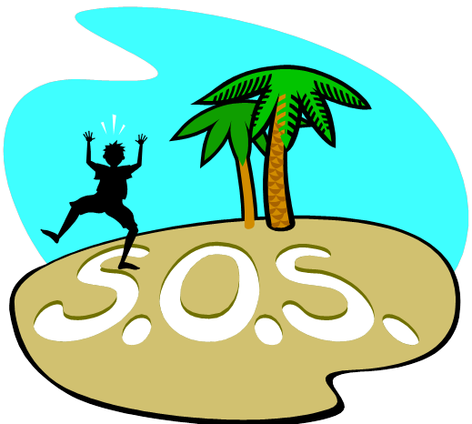
Call to Family
Call to Community
Call to Participation
What issues in the world today tug at your heart?
What expertise/resources do you have?
What connections do you have?

